Slide 1
Quine-Mc’Clusky’s and Moisil’s simplification methods

Slide 2

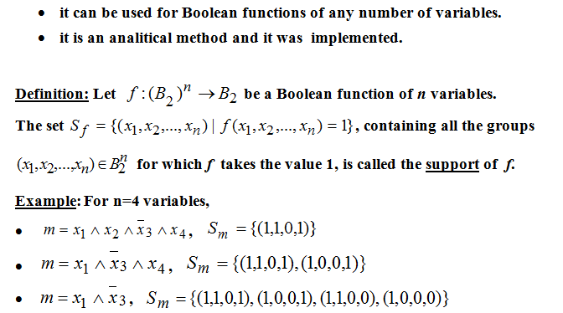
Quine’s method

Slide 3
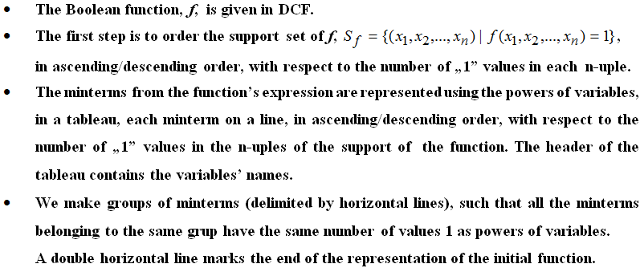
Quine’s Method –description (I)

Slide 4
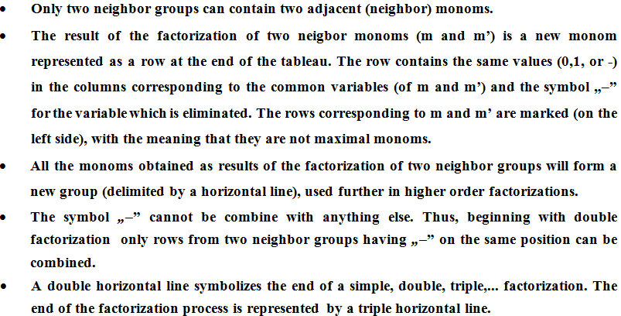
Quine’s Method –description (II)

Slide 5
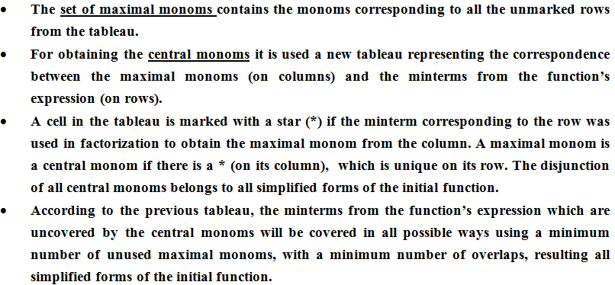
Quine’s Method –description (III)

Slide 6
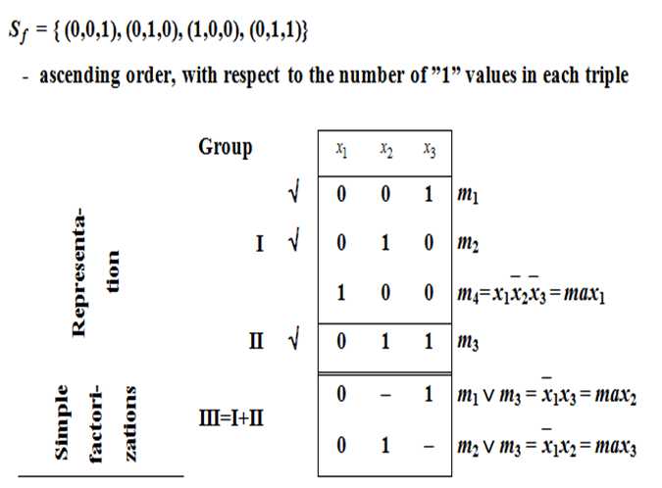
Example 1. Simplify the Boolean Function

Slide 7
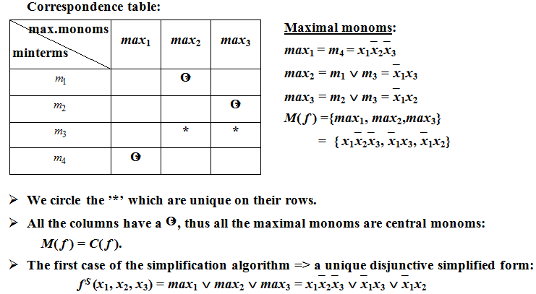
Example 1 (contd.)

Slide 8
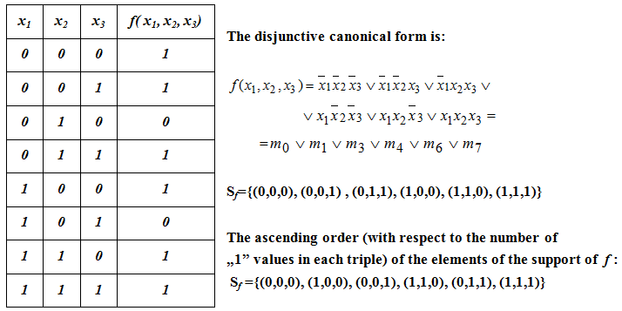
Example 2. Simplify the Boolean Function

Slide 9
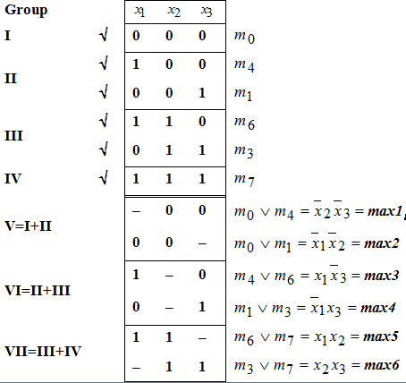
Example 2 – Factorization process

Slide 10
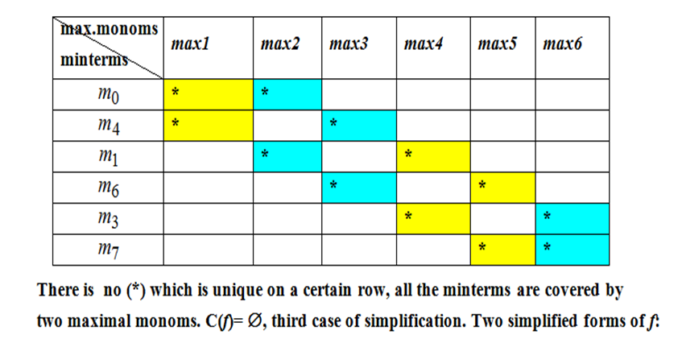
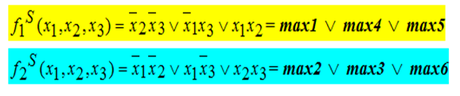
Example 2 (contd.)

Slide 11
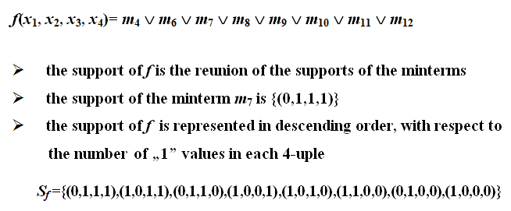
Example 3. Simplify the Boolean Function

Slide 12
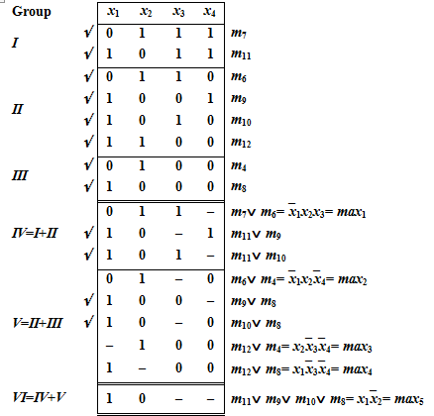
Example 3 – Factorization process

Slide 13
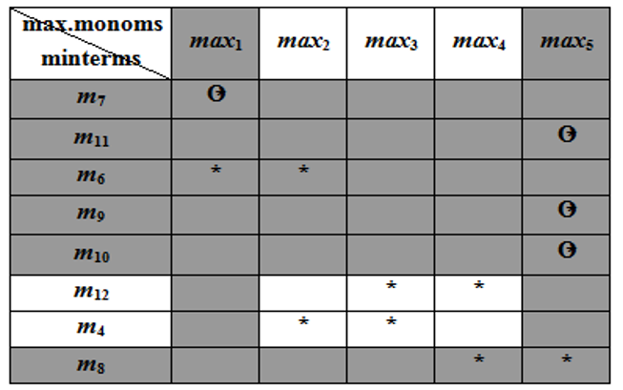
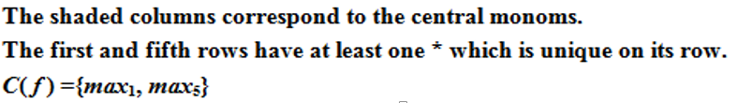
Example 3 – Central Monoms

Slide 14
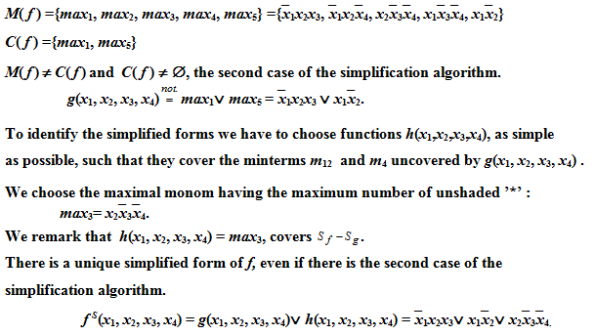
Example 3 – simplified forms

Slide 15
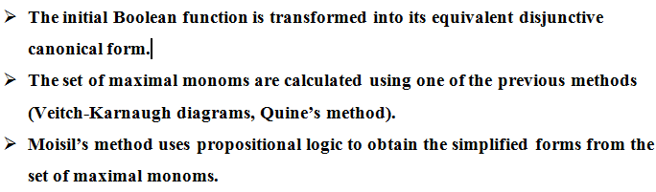
Moisil’s simplification method

Slide 16
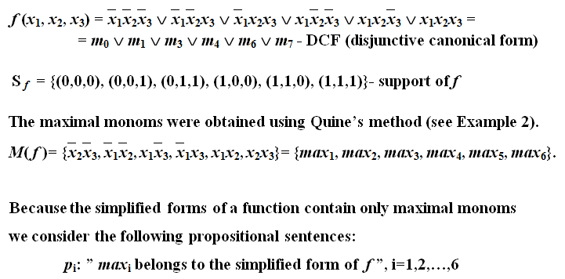
Example 4. Simplify the Boolean Function

Slide 17

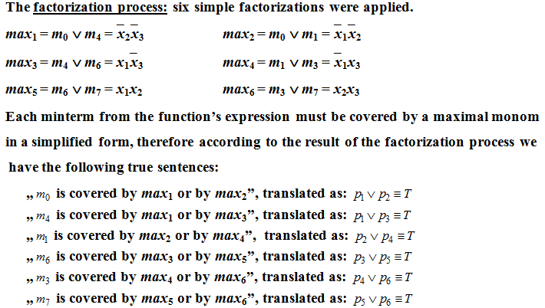
Example 4 (contd.)

Slide 18
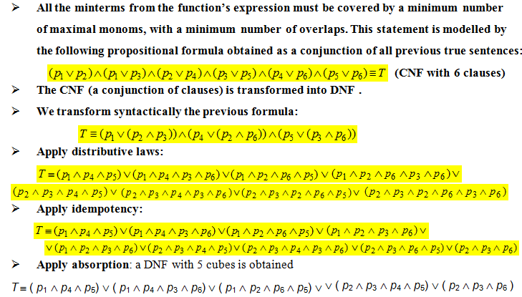
Example 4 (contd.)

Slide 19
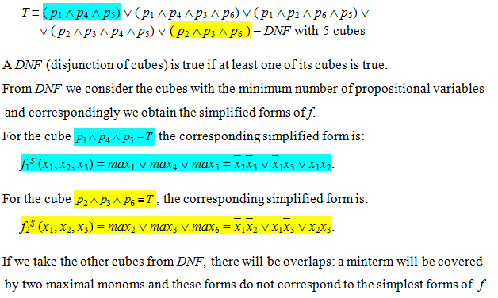
Example 4 (contd.)

Slide 20


